Slide 1
“Britain is a nation of shopkeepers”
Napoleon Bonaparte 1769-1821

Slide 2
4/10
1/2
45
72,000,000,000
3.6

Slide 3
4/10
1/2
45
72,000,000,000
3.6
Four in 10 Brits have a "side hustle", as workers worry about job security.
The number of workers with "side hustles", or secondary incomes, is set to increase to half of the adult population by 2030.
45% of side hustlers work more than 40 hours a week, citing money worries or wanting to follow a passion.
Side hustles generated £72bn for the UK economy last year, the equivalent of 3.6% of GDP.
Henley Business School 2018

Slide 4
Screenmatrix.com
Jeremy Nicholson
CEO
Jeremy@screenmatrix.com

Slide 5
The Agony
HM Revenue & Customs

Slide 6
The Ecstasy
For Microbusinesses, Screen Matrix is a better B2B2C product market platform for users, as it delivers integrated businesses information and services at a reasonable price.
For customers, it is better then eBay, Shopify and Schpock, because it uses push marketing to create and serve communities and grow customers.

Slide 7
Matching
Buy, Sell, Auction, Classified, Exposure
Money
Multiple payment channels
Measurement
Analytics, Dashboard
Management
KPIs, Benchmarking, Stock Control, Third Party Logistics

Slide 8
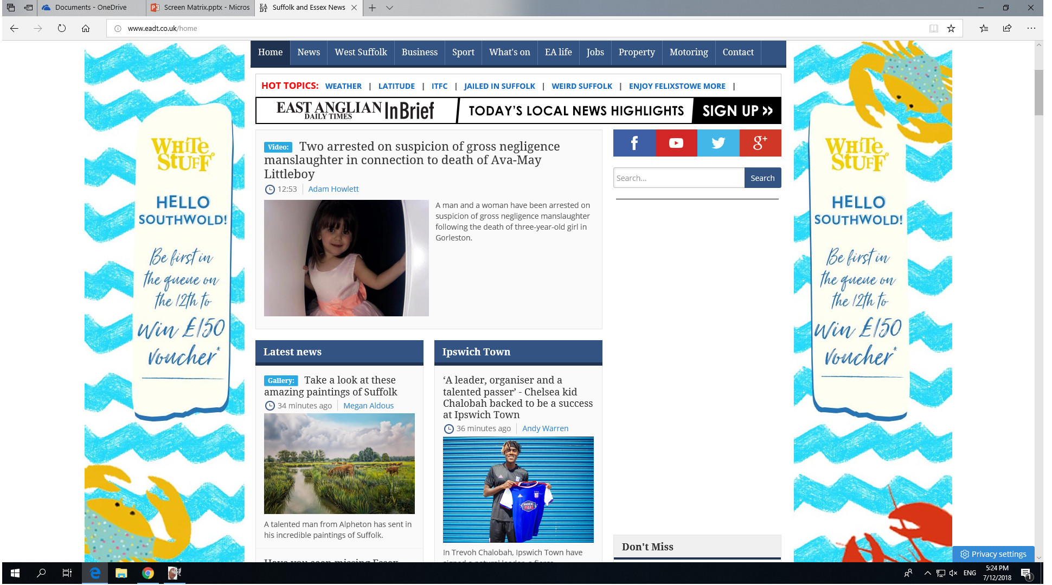
Marketing
Integration with marketing plug-ins using MAST process
Auto-updating “push” banners

Slide 10
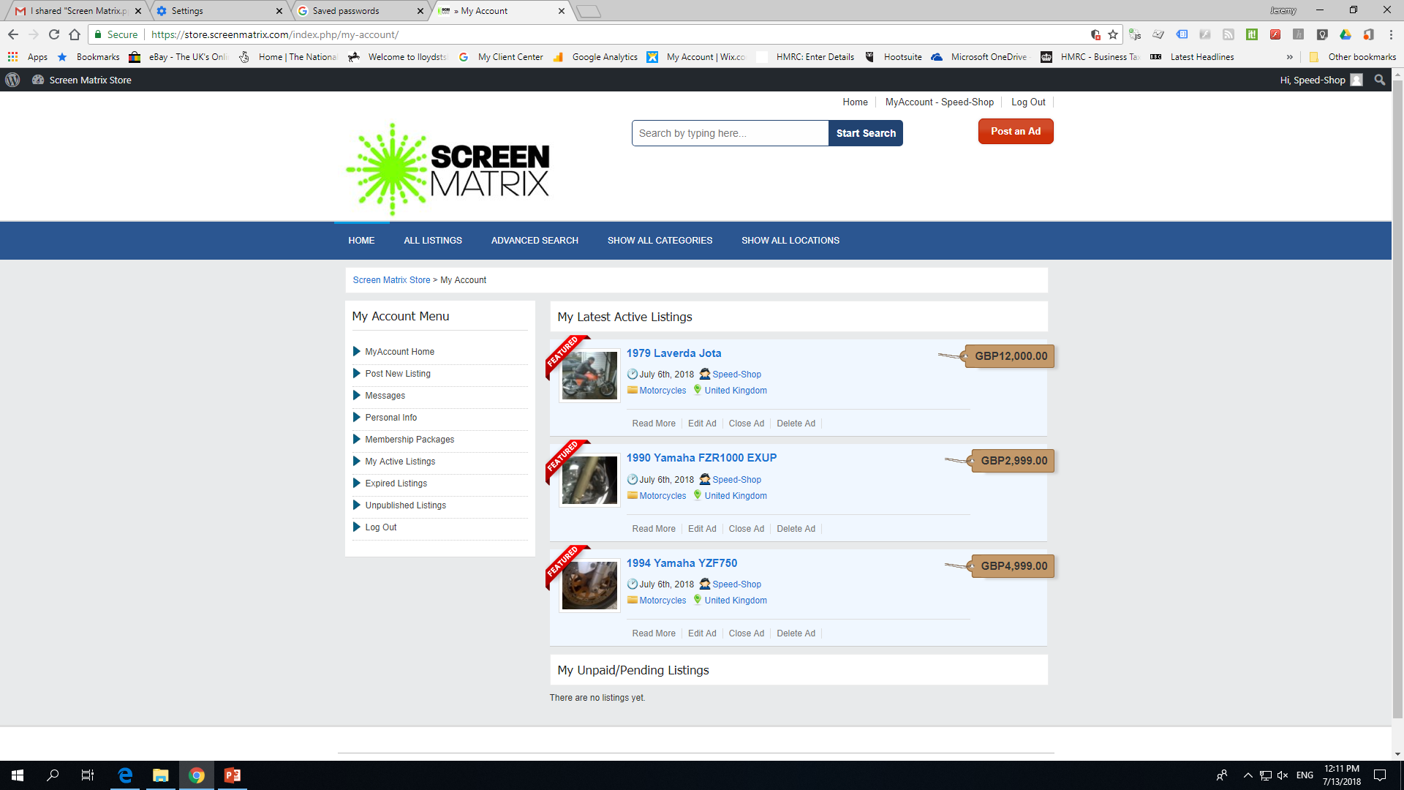

Slide 11
Team
Jeremy Nicholson, CEO: Strategy, Sales & Marketing (MAST)
Adrian Thompson, CTO: JSON, API, AI (Bots). Intel, NYSE
Helen Thomas, CFO: Deloittes, Goldman Sachs, ACA, CIOD, CJBS

Slide 12
Financials (Vision)
eBay has operations in 30 countries, revenues of $9 Billion per annum
Screen Matrix Year 1 Headlines
Average Subscription £20 pcm
Year 1 Run Rate 5,000 users
Year 1 Run Rate Revenue £1.2M
How do we get there?
D Day + 6 Months Customer Acquisition Target 1,000 customers pcm
Paid & Organic search, PR, Content, Social, Affiliate
Marketing £200k, Operations £50k

Slide 13
Ask
Contact
Visibility / Traction
Introductions
Affiliates, Channels, Resources
Jeremy Nicholson
Jeremy@screenmatrix.com

